Slide 1
Unit-2:PIC I/O Ports and Timer
Mr. Bhagwat K.S
Asst Prof
VPKBIET Baramati

Slide 2
I/O Port
I/O port structure:
To connect Microcontroller to the peripherals we use registers (called ports).
Ports are connected to the Microcontroller pins.
Pins can be configured to be o/ps or i/ps.
It is simply performed by program.

Slide 3
I/O PORT programming in PIC18
In PIC18 family, there are many ports for I/O operations, depending on which family member you choose.
Fig - PIC18F458 is 40-pin chip. A total of 33 pins are set aside for the 5 ports PORTA,PORTB, PORTC, PORTD, & PORTE
The Reset of the pins are designed as Vdd(Vcc), Vss(GND), OSC1,OSC2, MCLR(Reset), & another set of Vdd & Vss.

Slide 4
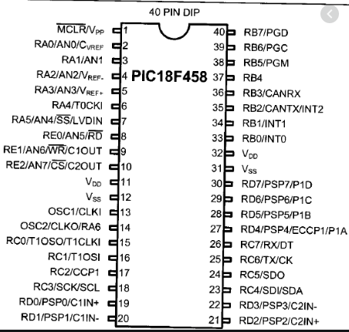
Fig: PICF458 Pin Diagram

Slide 5
I/O port pins & their functions
No of ports in the PIC18 family varies depending on the no of pins on the chip.
18-pin PIC18 has Ports A & B only, while the 64-pin version has Ports A through F, & the 80-pin PIC18 has ports A through L, as shown in table.
40-pin PIC18F458 has 5 ports. They are PORTA, PORTB, PORTC, PORTD, & PORTE.
To use any of these ports as an i/p or o/p port, it must be programmed.

Slide 6
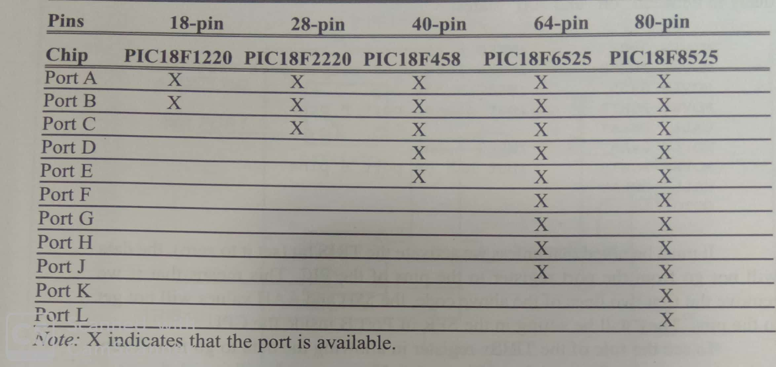
In addition to being used for simple I/O, each port has some other functions such as ADC, timers, interrupts, & serial communication pins.
Above Pin Dia also shows alternate functions for the PIC18F458 pins.

Slide 7
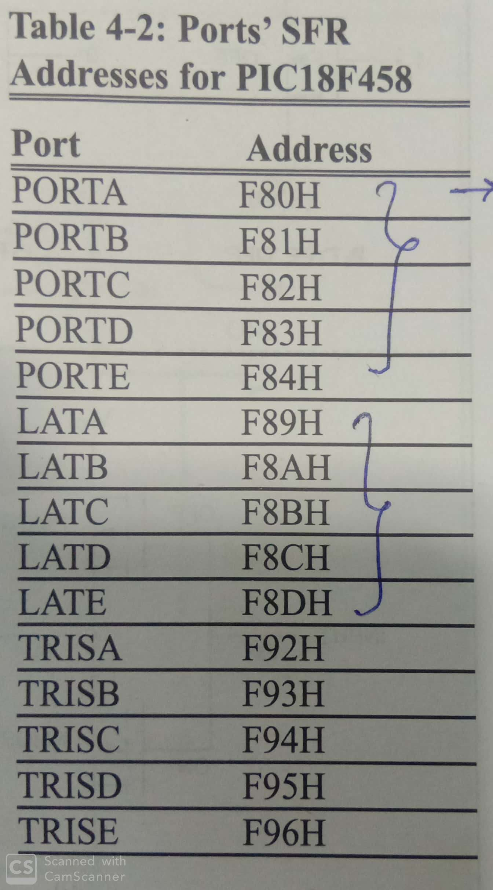
For e.g in PIC18F458,
Port A - 7 pins
Ports B,C,& D - 8 pins
Port E -3 pins.
Each Port has 3 SFRs associated with it, as shown in table. They are designed as PORTx, TRISx & LATx.
For e.g ,for Port B we have PORTB,TRISEB,
& LATB.
Note : TRIS – TRIState & LAT - LATCH.
We describe how to access the SFRs
associated with the ports.

Slide 8
TRIS register role in outputting data
Ports A-E in the PIC18F458 can be used for i/p or o/p.
TRISx SFR is used for making a given port an i/p or o/p port.
For e.g, To make a port an o/p, write 0s to the TRISx=0
In other words, to o/p data to any of the pins of the Port B, we must first put 0s into the TRISB register to make it an o/p port, & then send the data to the Port B SFR itself.

Slide 9
The following code will toggle all 8 bits of PortB forever with some time delay in between “on” & “off” states:
MOVLW 0x0 ; WREG=00
MOVWF TRISB ;make Port B an output port 0000 0000
L1 MOVLW 0x55 ;WREG=55h
MOVWF PORTB ; put 55h on port B pins
CALL DELAY
MOVLW 0xAA ; WREG=AAh
MOVWF PORTB ; put AAh on port B pins
CALL DELAY
GOTO L1

Slide 10
Note: TRIS bit set to 0, then only data will go from the port register to the pins of the PIC.
i.e if we remove 1st two lines of the above code, the 55H &AAH values will not get to the pins.
They will be sitting in the SFR of PortB inside the CPU.
Role of the TRISx register: It allowing the data to go from Portx to the Pins, examine fig-a & fig-b

Slide 11
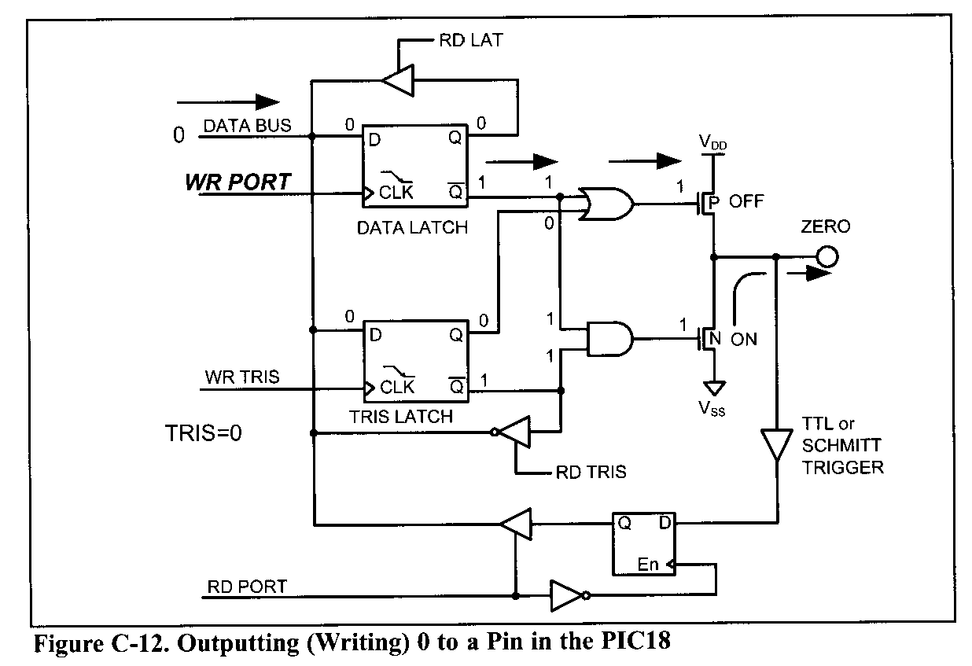
Outputting (Writing) ‘0’ on PORT
Fig-a: Outputting (Writing) 0 to a Pin in the PIC18

Slide 12
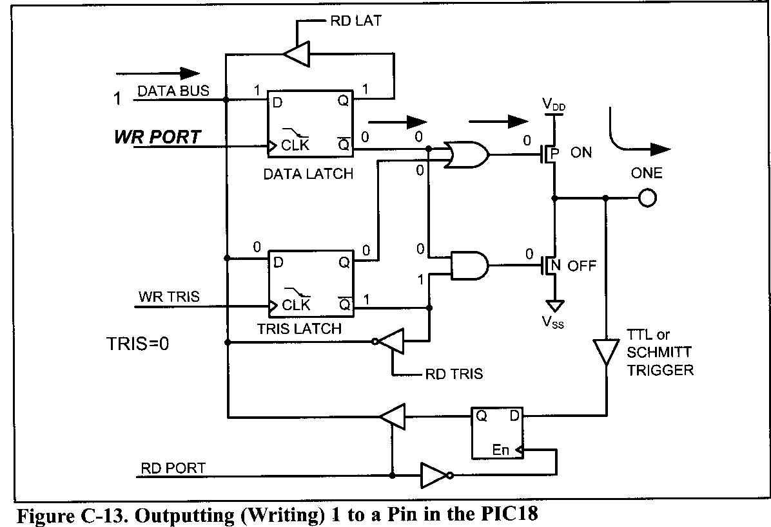
Outputting (Writing) ‘1’ on PORT
Fig-b: Outputting (Writing)1 to a Pin in the PIC18

Slide 13
TRIS register role in inputting data
To make a port an i/p port, we must 1st put 1s into the TRISx Register for that port,
& then bring in(read) the data present at the pins.
0 for out & 1 for in.
The following code will get the data present at the pins of PortC & send it to PortB indefinitely, after adding the value 5 to it.
MOVLW B ’00000000’ ;WREG=0000000(binary)
MOVWF TRISB ;Port B an output port( 0 for O)
MOVLW B ’11111111’ ;WREG=11111111(binary)
MOVWF TRISC ;Port C an input port( 1 for I)
L2 MOVF PORTC,W ;move data from Port C to WREG
ADDLW 5 ;add some value to it
MOVWF PORTB ;send it to Port B
GOTO L2 ;continue forever

Slide 14
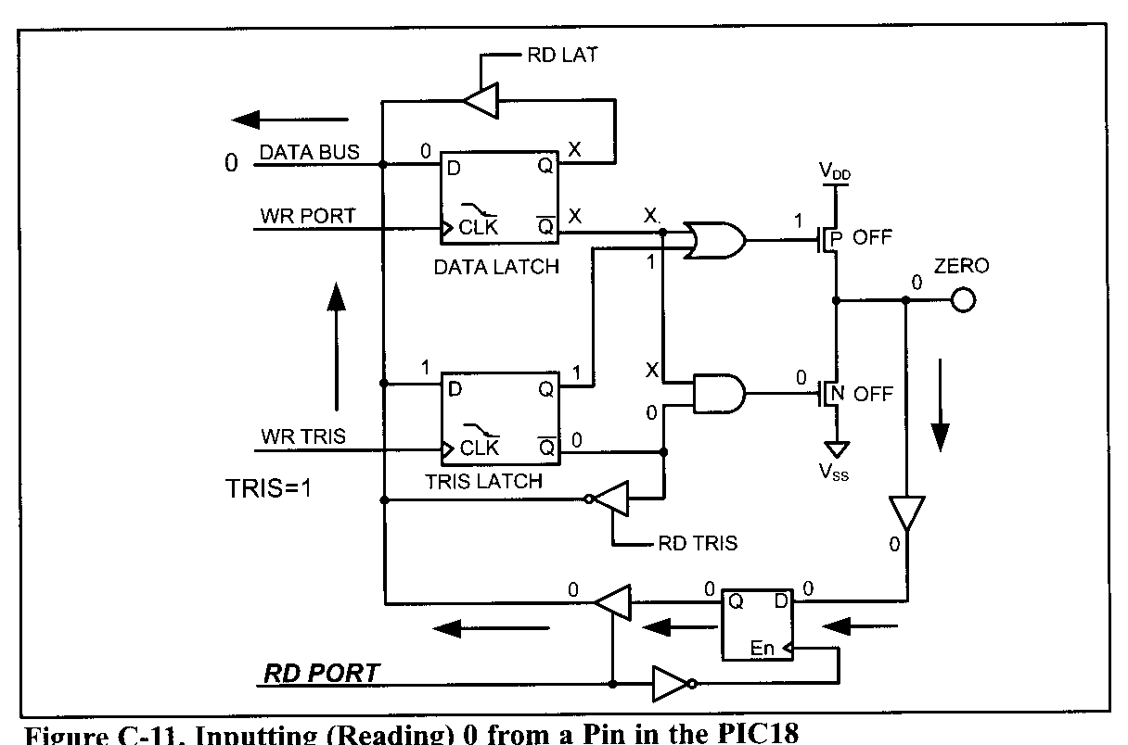
Role of the TRISx register: It allowing the data to come into the CPU from the pins examine following fig-a & fig-b
Fig-a: Inputting (Reading) 0 from a Pin in the PIC18

Slide 15
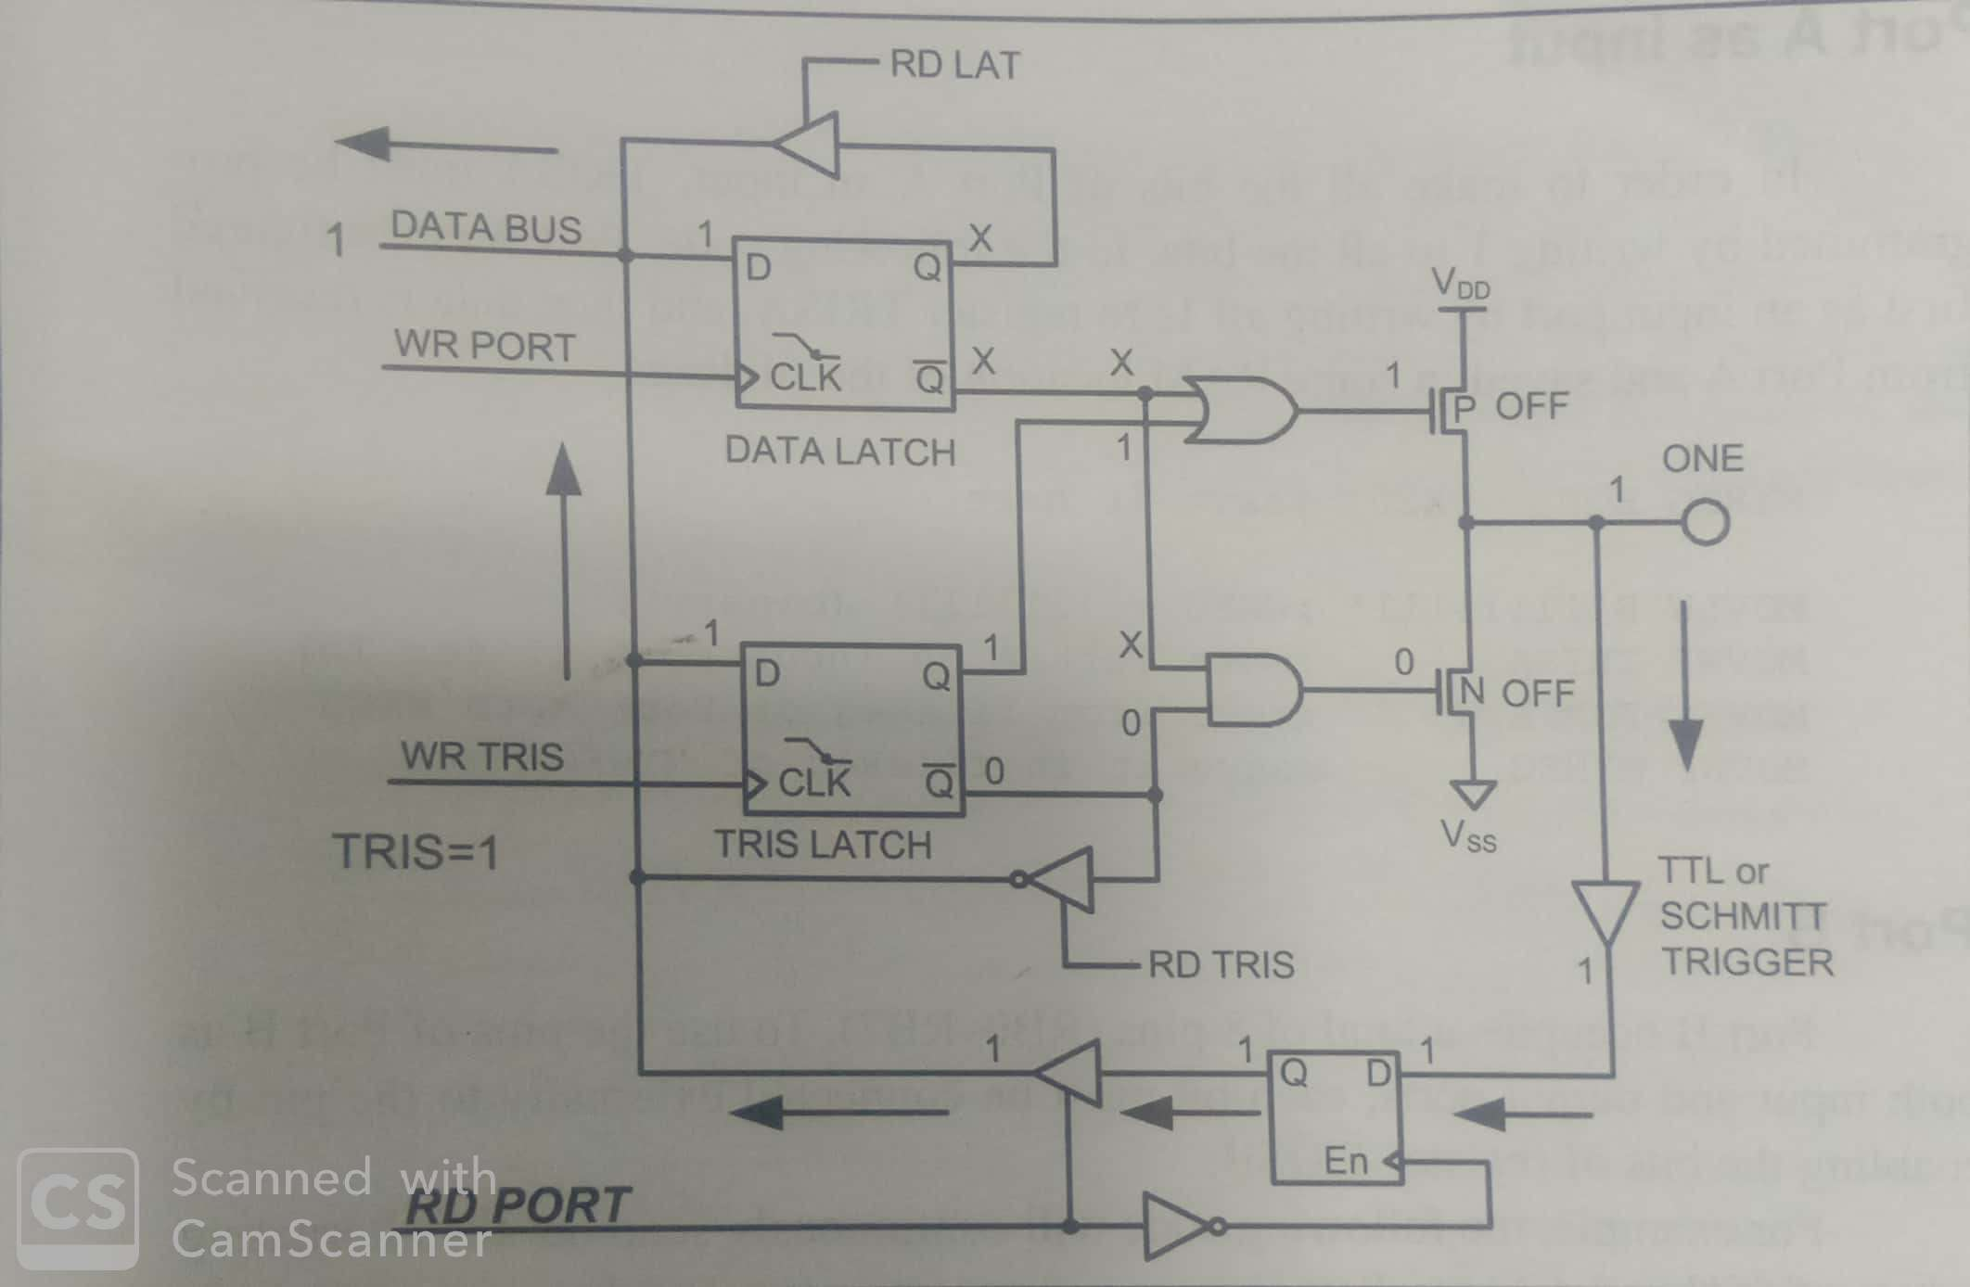
fig-b:Inputting (Reading) 1 from a Pin in the PIC18

Slide 16
Port A
PortA -7 pins(RA0-RA6),
But in PIC18F458, pin A6 is used for the OSC2 pin.
A6 is not available if we use a crystal oscillator to provide frequency to the PIC18 chip.
To use the pins of Port A as both i/p & o/p ports, each bit must be connected externally to the pin by enabling the bits of the TRISA Register.
MOVLW B’00000000’ ;WREG=00000000(binary)
MOVWF TRISA ; make Port A an output port (0 for Out)
MOVLW B’11111111’ ;WREG=11111111 (binary)
MOVWF TRISA ; make Port A an Input port ( 1 for In)

Slide 17
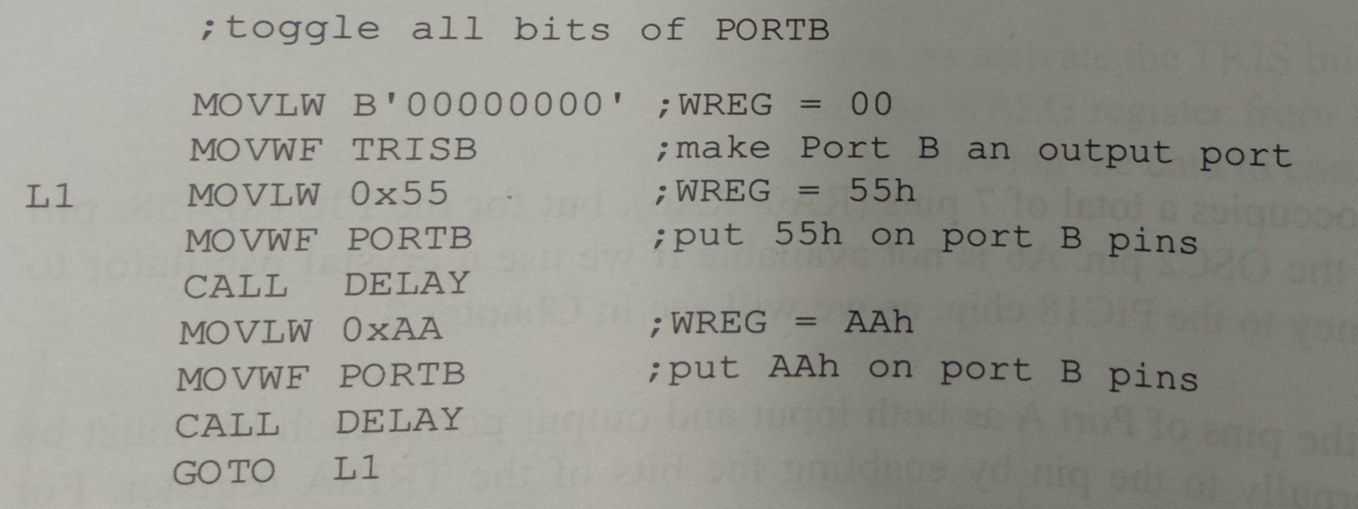
PortB
PortB -8 pins(RB0-RB7).
To use the pins of PortB as both i/p & o/p ports, each bit must be connected externally to the pin by enabling the bits of register TRISB.
For e.g following code will continuously send out the alternating values of 55H & AAH to portB:

Slide 18
In order to make all the bits of PortB an input, TRISB must be programmed by writing 1 to all the bits.
PortB is configured 1st as an i/p port by writing all 1s to register TRISB, & then data is received from PortB & saved in some RAM location of the fileReg.

Slide 19
Dual role of Ports A & B
PIC18 multiplexes an Analog-to-Digital converter through Port A to save I/O pins.
Alternate functions of the pins for PORTA are shown in TableA
Table-A
We do not use PortA for simple I/O functions.
Bit | Function
RA0 | AN0/CVREF
RA1 | AN1
RA2 | AN2/VREF-
RA3 | AN3/VREF+
RA4 | T0CKI
RA5 | AN4/SS/LVDIN
RA6 | OSC2/CLK0

Slide 20
PIC18 multiplexes some other functions through PORTB to save pins.
Alternate functions of the pins for PORTB are shown in TableB
Table-B
Bit | Function
RB0 | INT0
RB1 | INT1
RB2 | INT2/CANTX
RB3 | CANRX
RB4
RB5 | PGM
RB6 | PGC
RB7 | PGD

Slide 21
Port C
Port C- 8 pins (RC0-RC7).
To use the pins of PortC as both i/p & o/p ports, each bit must be connected externally to the pin by enabling the bits of register TRISC.
MOVLW B’00000000’ ;WREG=00000000 (binary)
MOVWF TRISC ;Make Port C an Output port(0 for out)
MOVLW B’11111111’ ;WREG=11111111 (binary)
MOVWF TRISC ;Make Port C an Input port(1 for In)

Slide 22
PortD
Port D -8 pins(RD0-RD7)
To use the pins of PORTD as both i/p & o/p ports, each bit must be connected externally to the pin by enabling the bits of register TRISD.
SETF TRISD ;TRISD=11111111 (binary)= PORTD=Input

Slide 23
Dual role of Ports C and D
Alternate functions of the pins for Port C are shown in TableA.
Alternate functions of the pins for Port D are shown in TableB.
Table A –PortC Alternate function Table B- Port D Alternate functions
Bit | Function
RC0 | T1OSO/T1CKI
RC1 | T1OSI
RC2 | CCP1
RC3 | SCK/SCL
RC4 | SDI/SDA
RC5 | SDO
RC6 | TX/CK
RC7 | RX/DT
Bit | Function
RD0 | PSP0/C1IN+
RD1 | PSP1/C1IN-
RD2 | PSP2/C2IN+
RD3 | PSP3/C2IN-
RD4 | PSP4/ECCP1/P1A
RD5 | PSP5/P1B
RD6 | PSP6/P1C
RD7 | PSP7/P1D

Slide 24
PortE
PortE -3 pins(RE0-RE2) in the PIC18F458/4580.
Port E is used for 3 additional Analog inputs or Simple I/O: AN5, AN6, & AN7. Just like other ports, PortE has alternate functions.

Slide 25
I/O Bit Manipulation Programming.
In this section we further examine the PIC18 I/O instructions.
We pay special attention to I/O bit manipulation because it is a powerful & widely used feature of the PIC family.
I/O ports & bit-addressability:
Sometimes we need to access only 1 or 2 bits of the port instead of the entire 8 bits.
PIC I/O ports is their capability to access individual bits of the port without altering the rest of the bits in that port.
For all PIC ports, we can access either all 8 bits or any single bit without altering the rest.

Slide 26
Following Table-A lists the Single-bit instructions for the PIC18.
Table-A: lists the Single-bit instructions for the PIC18.
Although the instructions in Table-A can be used for any registers in the data RAM file register, I/O port operations use them most often.
Instruction | Function
BSF fileReg, bit | Bit Set fileReg (set the bit: bit=1)
BCF fileReg, bit | Bit Clear fileReg (clear the bit: bit=0)
BTG fileReg, bit | Bit Toggle fileReg (complement the bit)
BTFSC fileReg, bit | Bit test fileReg, skip if clear(skip next instruction if bit=0)
BTFSS fileReg, bit | Bit test fileReg, skip if clear(skip next instruction if bit=1)

Slide 27
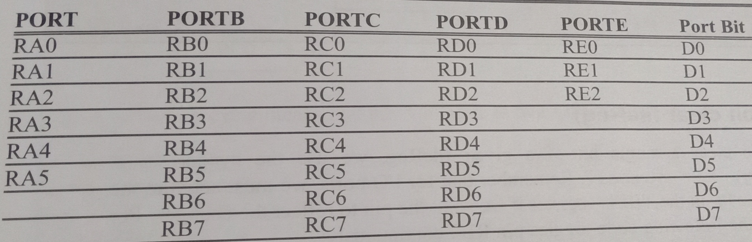
Table-B :Single-Bit Addressability of Ports for PIC18F458
BSF (Bit Set FileReg):
To set high a single bit of a given fileReg
Syntax: BSF fileReg, bit_num ; where fileReg can be any location in the file register & bit_num: 0 to 7.
e.g BSF PORTB, 5

Slide 28
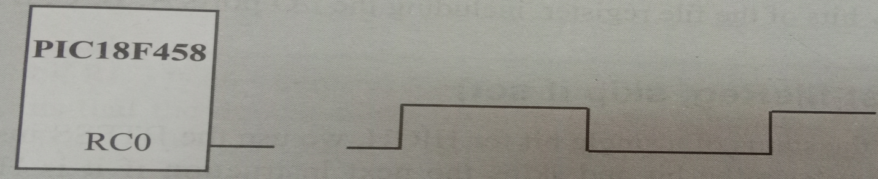
BCF (Bit Clear fileReg)
Clear a single bit of a given fileReg.
Syntax: “BCF fileReg, bit_number”
E.g BCF PORTB,2 ;bit clear(RB2=low).
Write a program to create a square wave of 50% duty cycle on bit0 of Port C.
Sol: 50% duty cycle means that the “ON” & “OFF” states (or the high & low portions of the pulse) have the same length. Therefore, we toggle RC0 with a time delay between each state.
BCF TRISC, 0 ;make RC0=out
HERE BTG PORTC,0 ;complement bit 0 of PORTC
CALL DELAY ;call the delay subroutine
BRA HERE ;keep doing it

Slide 29
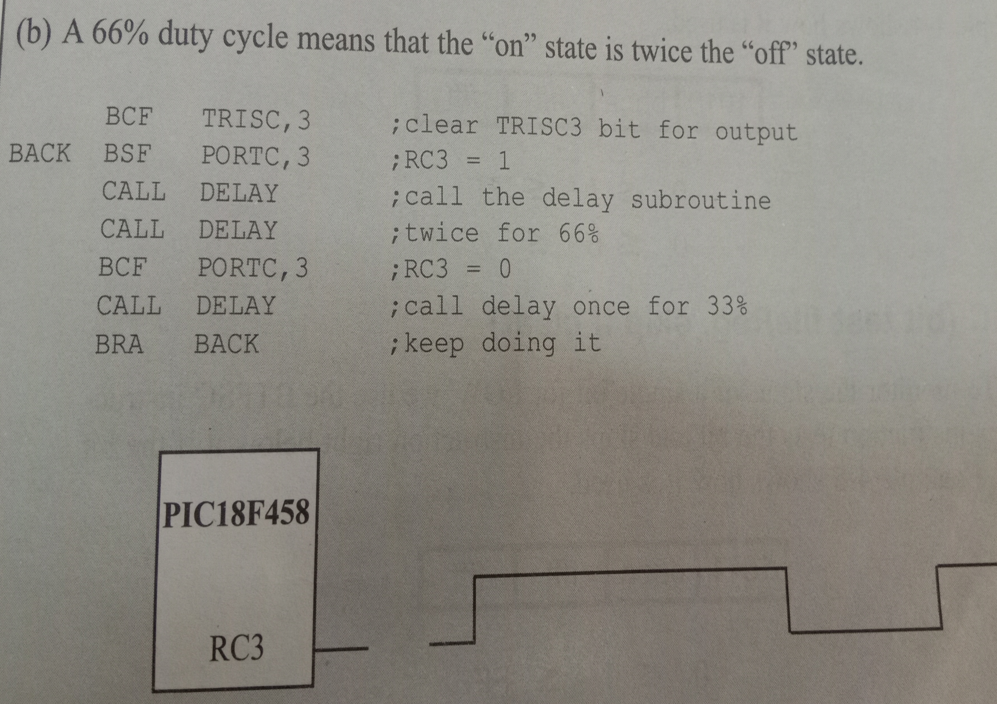

Slide 30
BTG (Bit Toggle fileReg)
Toggle a single bit of a given fileReg ,
Syntax: “BTG fileReg, bit_number”
e.g BTG PORTB,2 ;toggle pin RB2 only
Checking an input pin:
To make decisions based on the status of a given bit in the file register, we use the instructions BTFSC(bit test fileReg skip if clear) & BTFSS(bit test fileReg skip if set).
These single bit instructions are widely used for I/O operations.

Slide 31
BTFSS(bit test fileReg, skip if set)
To monitor the status of a single bit for HIGH, we use the BTFSS instruction.
This instruction tests the bit & skips the next instruction if it is HIGH.
See example 4.4.
BTFSC(bit test fileReg, skip if clear)
To monitor the status of a single bit for LOW, we use the BTFSC instruction.
This instruction tests the bit & skips the instruction right below it if the bit is LOW

Slide 32
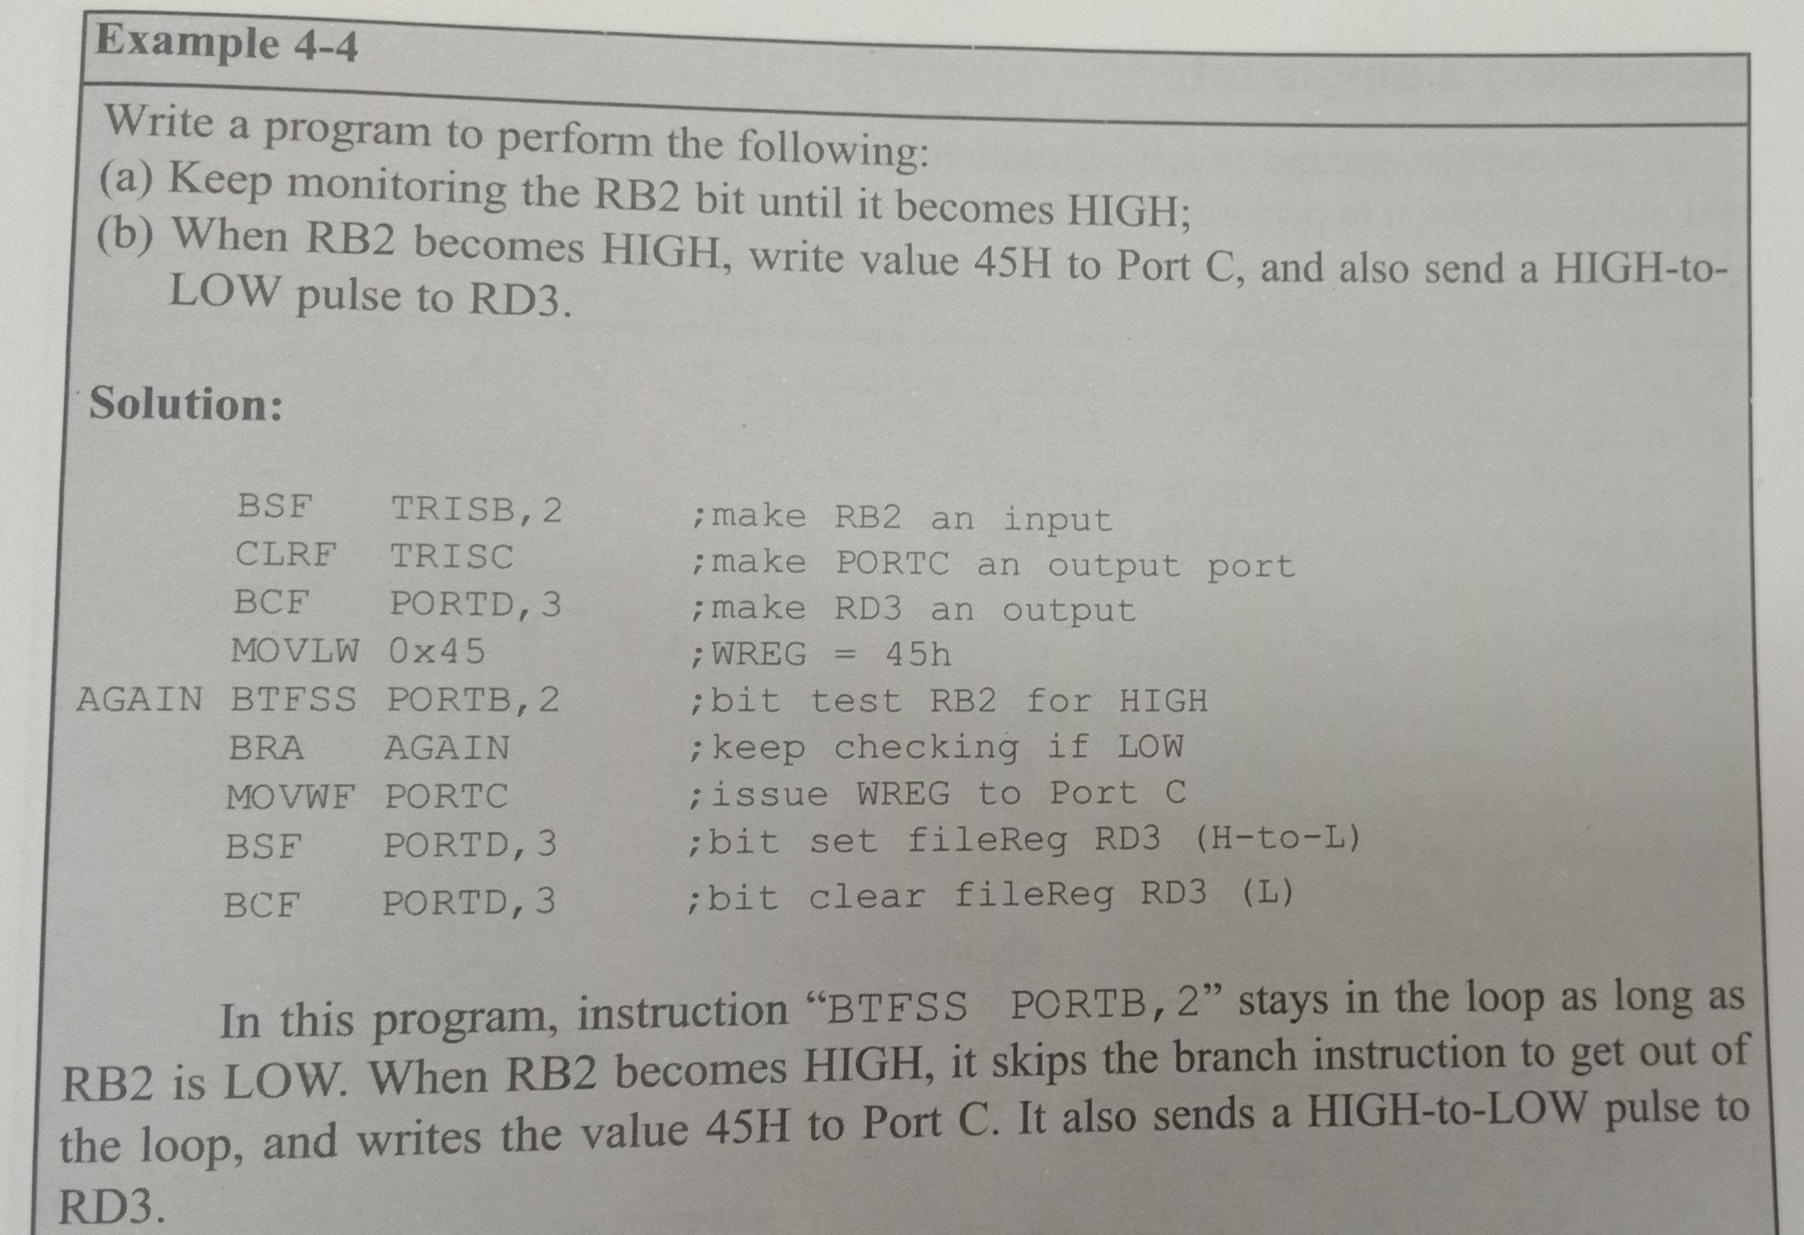

Slide 33
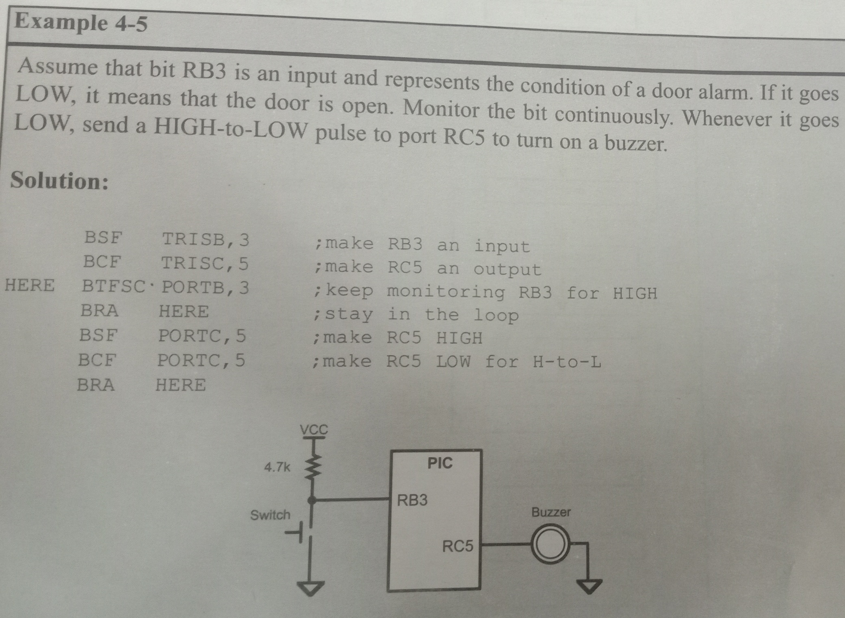

Slide 34
PIC18 Timers/Counters
PIC18FXXX has 2 to 5 Timers.
Such as Timers 0,1,2,3,&4.
Timers can be used either as Timers to generate a Time Delay or
Timers as Counters to Count Events happening outside the Microcontroller.

Slide 35
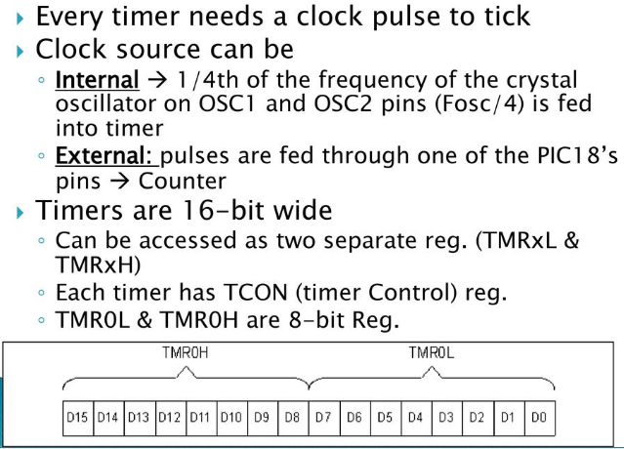
Timer0 & Timer1 Registers & Programming

Slide 36
Basic Registers of the Timer
PIC18 Timers are 16 bits wide.
As PIC18 has an 8-bit architecture, each 16-bit Timer is accessed as 2 separate registers of Low Byte(TMRxL) & high byte(TMRxH).
Each Timer also has the TCON(Timer Control ) register for setting modes of operation.

Slide 37
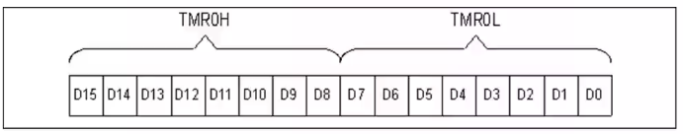
Timer0 Registers & Programming-
Timer0- used as an 8-bit or 16-bit timer.
16-bit Register of Timer0 is accessed as Low Byte(TMR0L) & High Byte(TMR0H), as shown in fig.
TMR0L-(i.e Timer0 Low Byte) & TMR0H-(i.e Timer0 High Byte) both are 8-bit registers.
Instruction for accessing these registers:
MOVWF TMR0L ;moves values in WREG into TMR0L
MOVFF TMR0L, PORTB ;copies TMR0L to PORTB

Slide 38
T0CON(Timer0 Control) Register
Each Timer has a Control register called TCON, to set the various Timer Operation Modes.
T0CON (8-bit) register used for control of Timer0.
Bits for T0CON are shown in following fig:

Slide 39
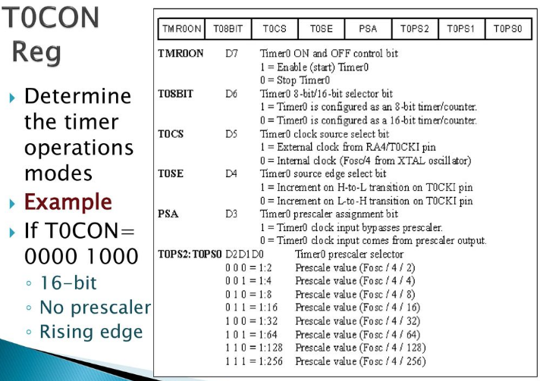

Slide 40
T0CS(Timer0 Clock Source i.e D5 bit from T0CON reg):
This bit in the T0CON Register is used to decide whether the Clock source is Internal (Fosc/4) or External.
If T0CS=0, then the Fosc/4 is used as clock source. In this case, the Timers are often used for Time Delay generation.
If T0CS=1, the clock source is External & comes from the RA4/T0CKI, which is pin6 on the DIP package of PIC18F4520.
When the Clock source comes from an External source , the Timer is used as an Event counter.

Slide 41
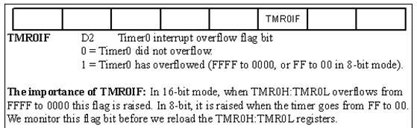
TMR0IF flag bit (Timer0 Interrupt Flag) bit-
It is part of the INTCON(Interrupt Control) register. See fig.
Fig: INTCON (Interrupt Control Register) has the TMR0IF Flag
When Timer reaches its maximum value of FFFFH, it rolls over to 0000, & TMR0IF is set to 1. See following fig

Slide 42
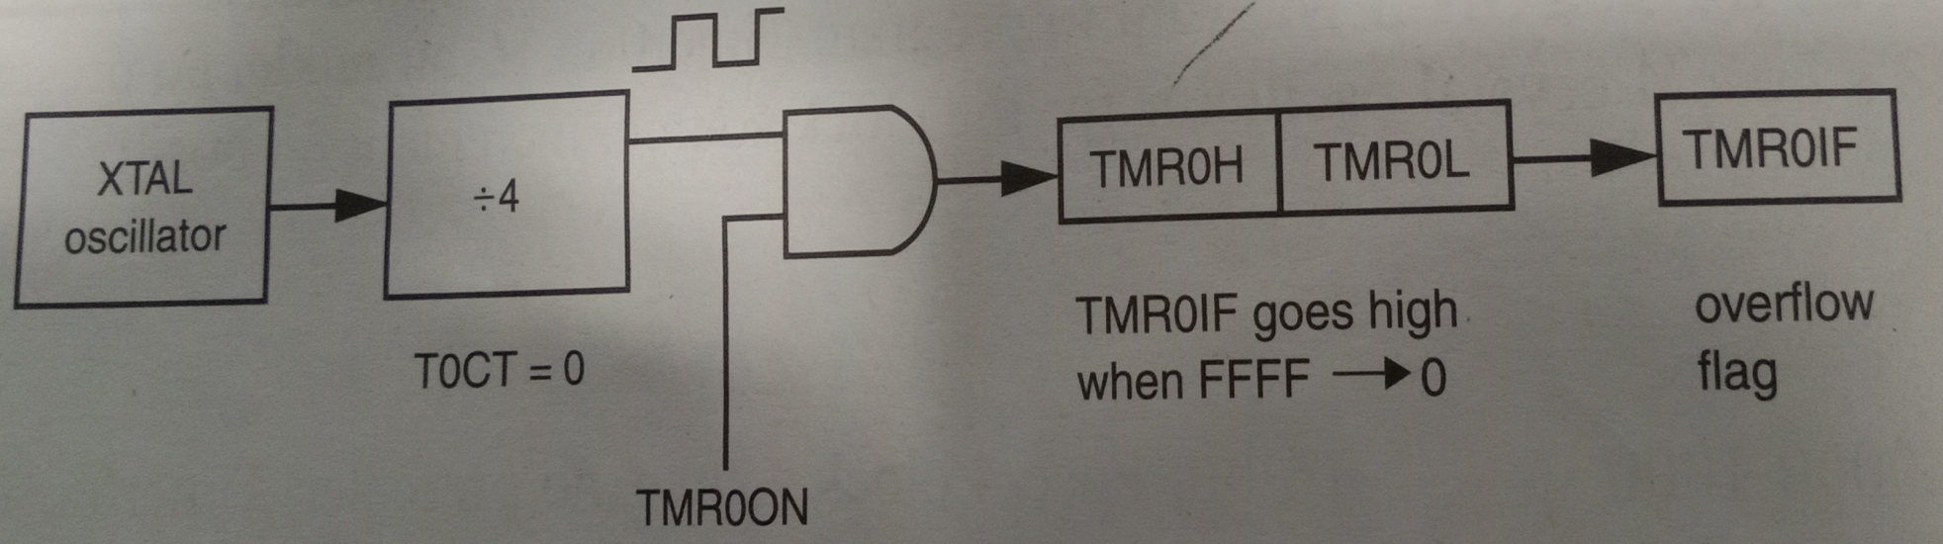
Fig- Timer0 Overflow Flag

Slide 43
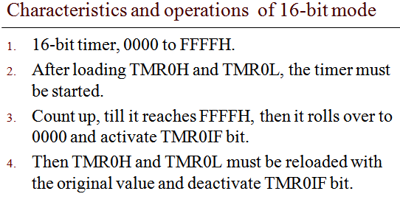
16-bit timer Programming

Slide 44
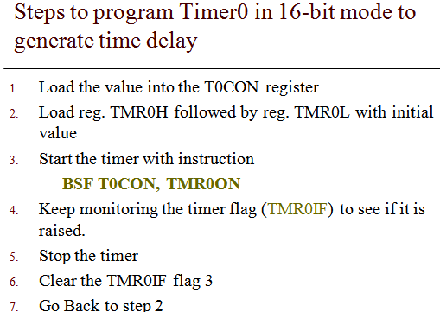

Slide 45
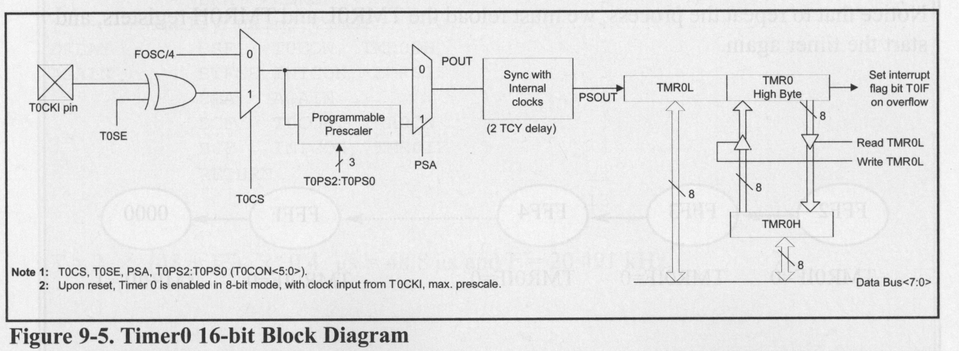
Notice in following fig We should load TMR0H first, & then load TMR0L,
Because the value for TMR0H is kept in a temporary register & written to TMR0H when TMR0L is loaded.
This will prevent any error in counting if the TMR0ON flag is set HIGH.
Fig: Timer0 16-bit block diagram.

Slide 46
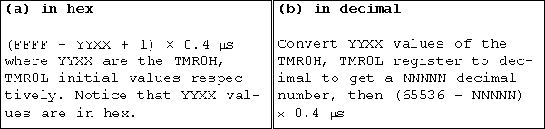
Timer Delay Calculation for XTAL = 10 MHz with No Prescaler
To calculate the exact time delay & square wave frequency generated on pin PB5, we need to know the XTAL frequency.
General formula for Delay calculation
T = 4/(10MHz) = 0.4 usecond
We can develop a formula for delay calculations using 16-bit mode of the timer for a crystal frequency of XTAL=10 MHz.

Slide 47
Example: Calculate the amount of time delay generated by the timer. Assume that XTAL=10MHz.
Solution:
-Timer works with the Fosc/4 clock;
-Therefore, we have 10MHz/4=2.5 MHz as the timer frequency.
-As a result, each clock has a period of T=1/2.5 MHz=0.4us.
-In other words, Timer0 counts up each 0.4 us resulting in delay=no of countsX0.4 us.
-Number of counts for the rollover is FFFFH-FFF2H=0DH(13 decimal).
-However, we add one to 13 because of the extra clock needed when it rolls over from FFFF to 0 & raises the TMR0IF flag.
-This gives 14X0.4us=5.6us for half the pulse.
-For the entire period the time delay generated by the timer is T=2X5.6us=11.2us.

Slide 48
Timer Calculation
Calculate total delay generated by Timer 0 if (FFF2)H is loaded into it.
Total pulse required to roll over =(FFFF – FFF2)+1
=(0E) Hex
= 14 decimal
Timer frequency = 10MHz / 4 = 2.5MHz
So, period(T) of Timer = 1 / 2.5MHz = 0.4usec
Total delay = total pulse * 0.4 usec
= 14 *0.4usec
= 5.6 usec

Slide 49
Prescaler & Generating a Large Time Delay
The size of the time delay depends on 2 factors:
The Crystal frequency
The Timer’s 16-bit register.
The largest timer delay happens when TMR0L=TMR0H=0
Prescaler option is used to duplicate the delay by dividing the clock by a factor of 2,4, 8,16, 32,64 ,128,256
- If T0CON=0000 0101, then T = 4*64/f
XTAL Osc
÷ 4
÷ 64
TMRx

Slide 50
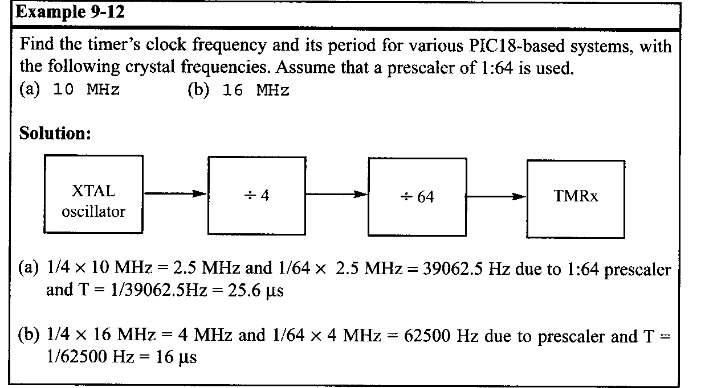

Slide 51
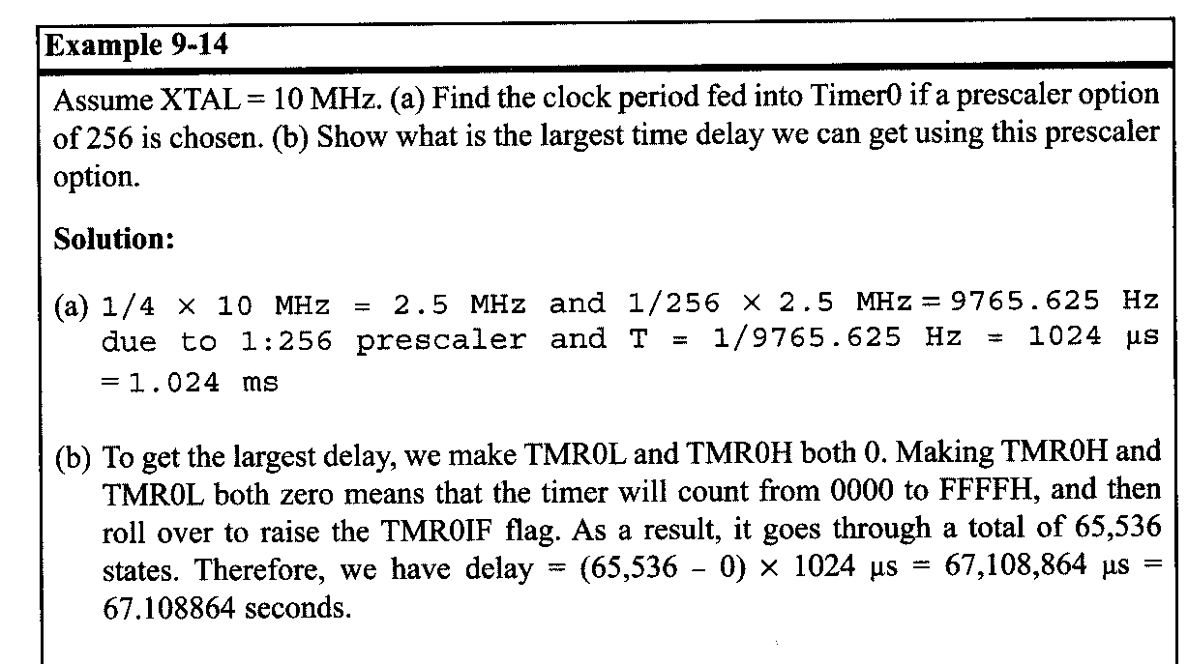

Slide 52
8-Bit Mode Programming of Timer0
Timer0 can also be used in 8-bit mode.
8-bit mode allows only values of 00 to FFH to be loaded into the timers register TMR0L.
After the timer is started, it starts to count up by incrementing the TMR0L register.
It counts up until it reaches its limit of FFH.
When it rolls over from FFH to 00, it sets HIGH the TMR0IF

Slide 53
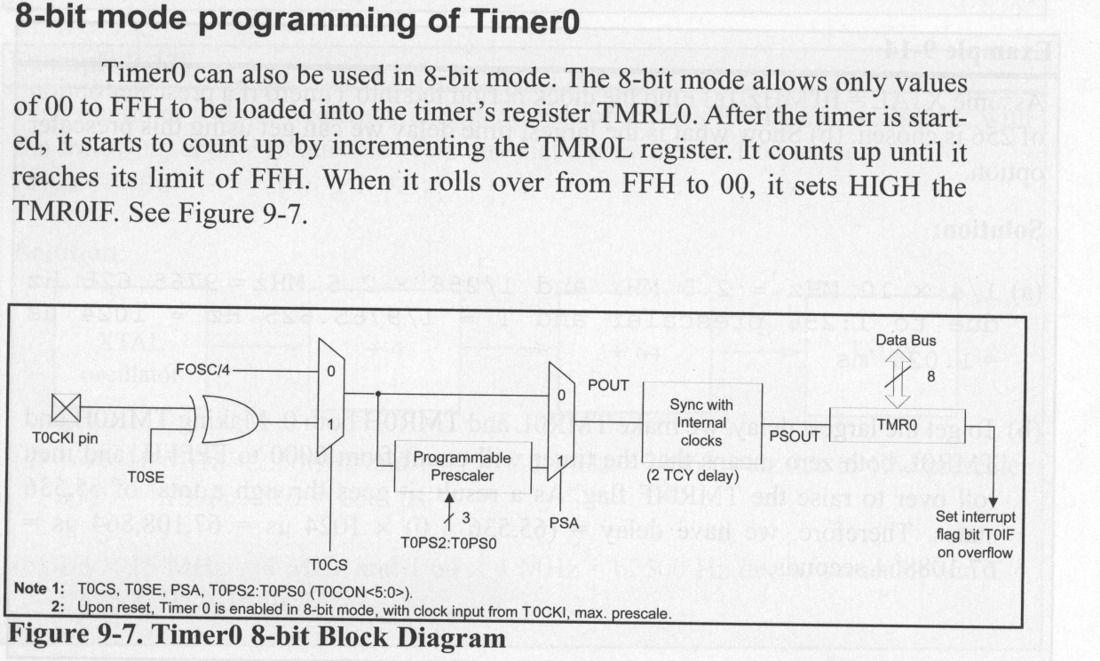
Fig- Timer0- 8-bit Block Diagram.

Slide 54
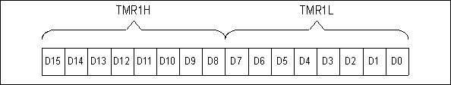
Timer1 Programming
Timer1 is a 16-bit Timer.
Its 16-bit register is split into 2 bytes, referred to as TMR1L(Low byte) & TMR1H(high byte).
See fig-A Timer1 can be programmed in 16-bit mode only & unlike Timer0, it does not support 8-bit mode.
fig-A Timer1 High & Low Registers

Slide 55
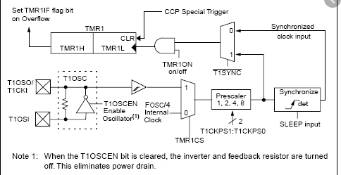
Timer1 has the T1CON register in addition to the TMR1IF(Timer1 interrupt flag).
TMR1IF flag bit goes HIGH when TMR1H:TMR1L overflows from FFFF to 0000.
Timer1 has the prescaler option, but it only supports factors of 1:1,1:2,1:4, & 1:8 see fig-B for Timer1 Block Diagram.
Fig.B Timer1 Block Diagram

Slide 56
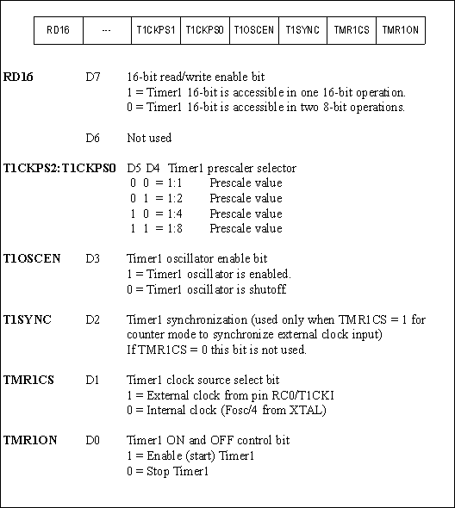
Fig –C: T1CON (Timer 1 Control ) Register
See fig-C for T1CON register options.

Slide 57
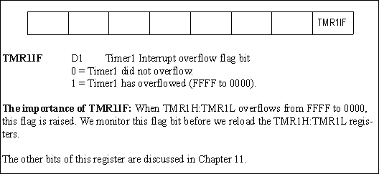
The PIR1(Interrupt Control Register 1) register contains the TMR1IF flags. See fig-D.
Fig-D PIR1(Interrupt Control Register1) contains the TMR1IF flag.

Slide 58
Counter Programming
Timers- can also be used as counters to count events happening outside the PIC18.
When timer is used as a timer-the PIC18 crystal(internal) is used as the source of the frequency.
When it is used as a counter-however, it is a pulse outside the PIC18 that increments the TH,TL registers.
In Counter mode, notice that registers such as T0CON, TMR0H, &TMR0L are the same as for the timer discussed in the last section

Slide 59
T0CS bit in T0CON register-
It decides the source of the clock for the timer.
When T0CS = 1, the timer is used as a counter & gets its pulses from outside the PIC18.
When T0CS=1, the counter counts up as pulses are fed from pin RA4(PORTA.4)(i.e PIN T0CKI- Timer0 Clock Input).
lly , for Timer1, when TMR1CS=1, the timer 1 counts up as clock pulses are fed into pin RC0.

Slide 60
Using External Crystal for Timer1 clock
Timer1 comes with two options:
a) External Clock fed into the T1CKI pin
-T1OSCEN=0
b) Clock from a crystal connected to T1OSI-T1OSO (additional)
T1OSCEN=1
32 kHz Crystal is connected to the T1OSI &T1OSO pins &
It is used to provide clock to Timer1 for saving power during SLEEP mode, while the main crystal is shut down.
Bcz SLEEP instruction does not disable Timer1.

Slide 61
Programming TIMERS 0 & TIMERS1 IN C
Accessing Timer Registers in C:
In C18 we can access Timer Registers such as TMR0H,TMR0L & T0CON directly using the PIC18Fxxx.h header file.(see example).
C18 also access the TMR0ON & TMR0IF flag bits.(note: all the SFR registers are bit-accessible).
Calculating Delay length using Timers:
Delay length depends on 2 factors a) the crystal frequency b) the prescaler factor.
The 3rd factor in the delay size is the C compiler because various C compilers generate different hex code sizes

Slide 62
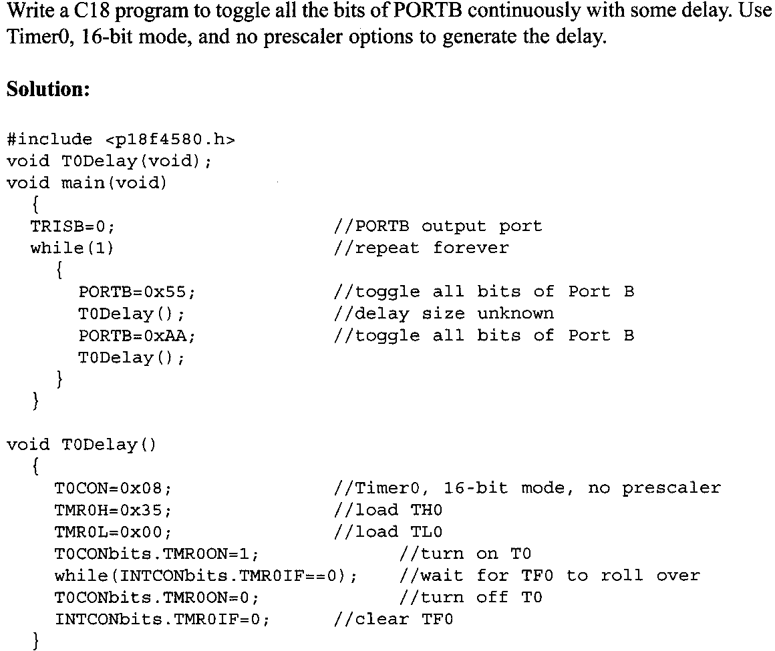

Slide 63
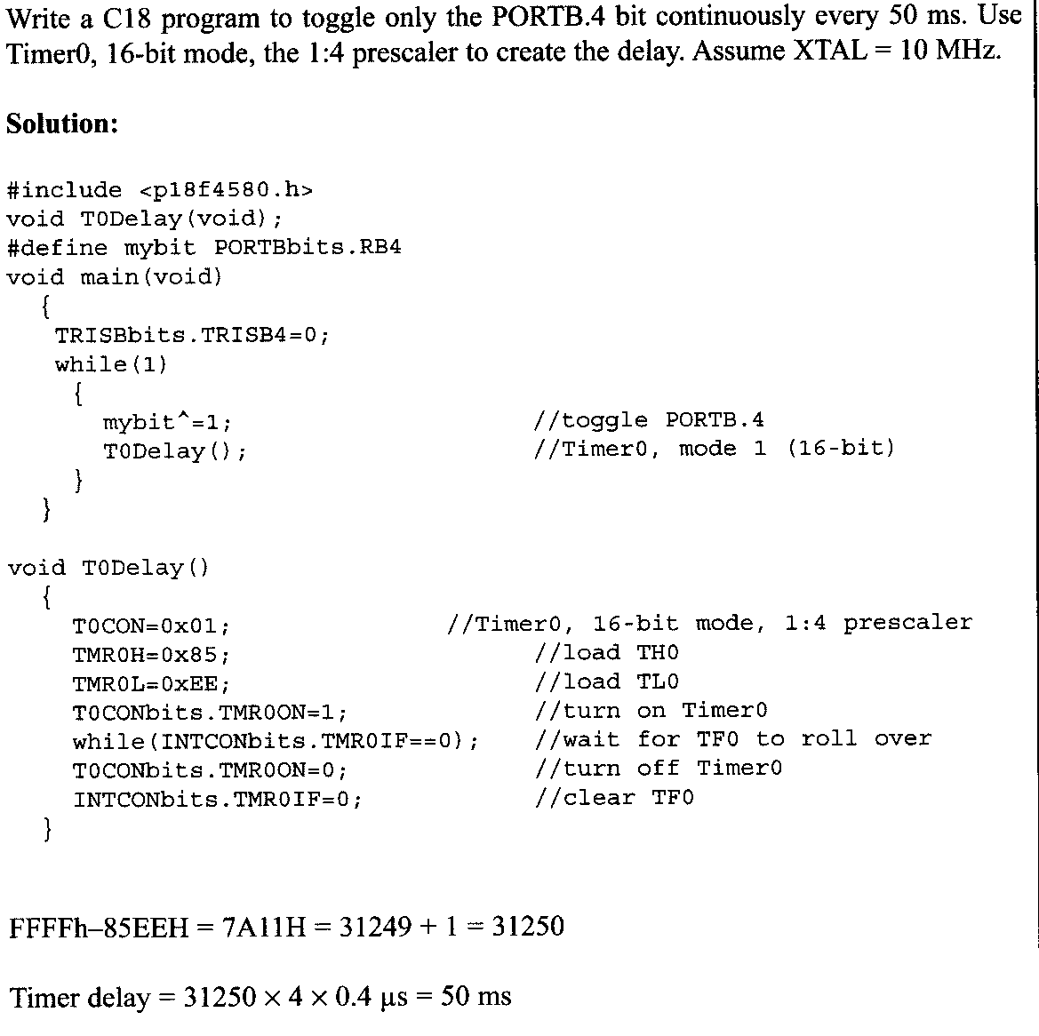

Slide 64
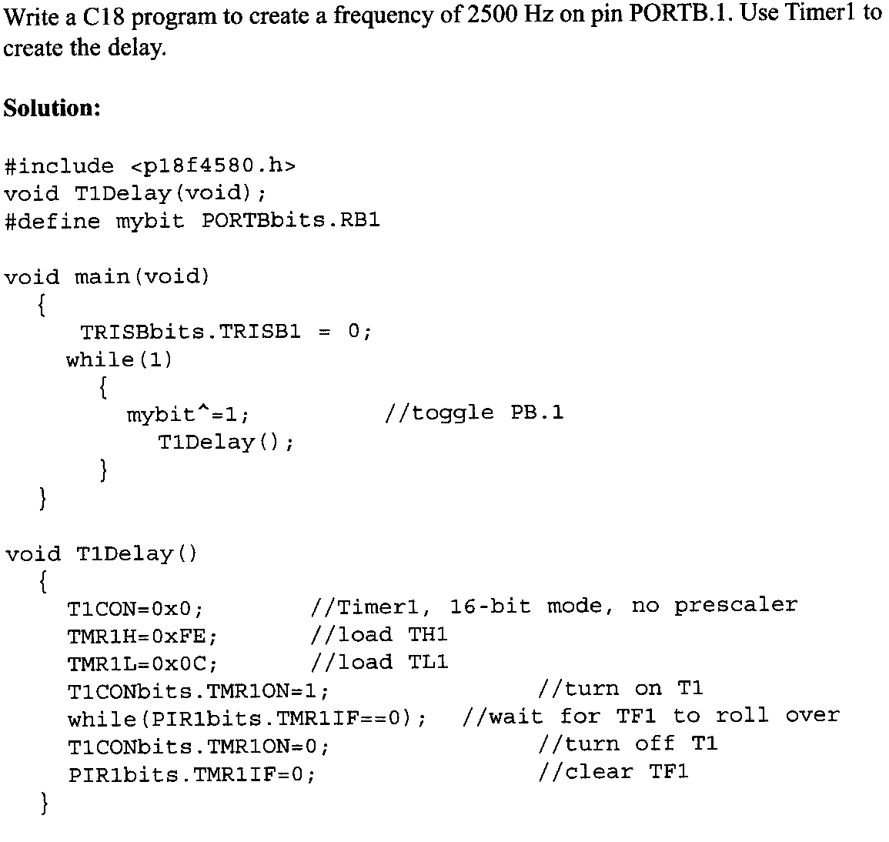

Slide 65
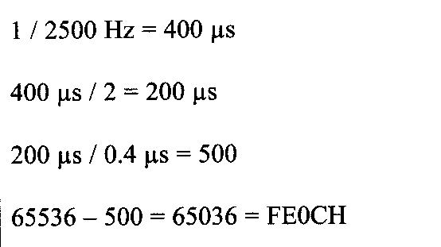

Slide 66
C Programming of Timers 0 & 1 as Counters
We use Timers0 & 1 as Event Counters.
Timers can be used as Counters if we provide pulses from outside the chip instead of using the frequency of the crystal oscillator as the clock source.
By feeding pulses to the T0CKI(RA4)& T1CKI(RC0) pins, we turn Timer0 & Timer1 into Counter0 & Counter1, resp.
In following examples see how Timers0 & 1 are programmed as counters using C language.

Slide 67
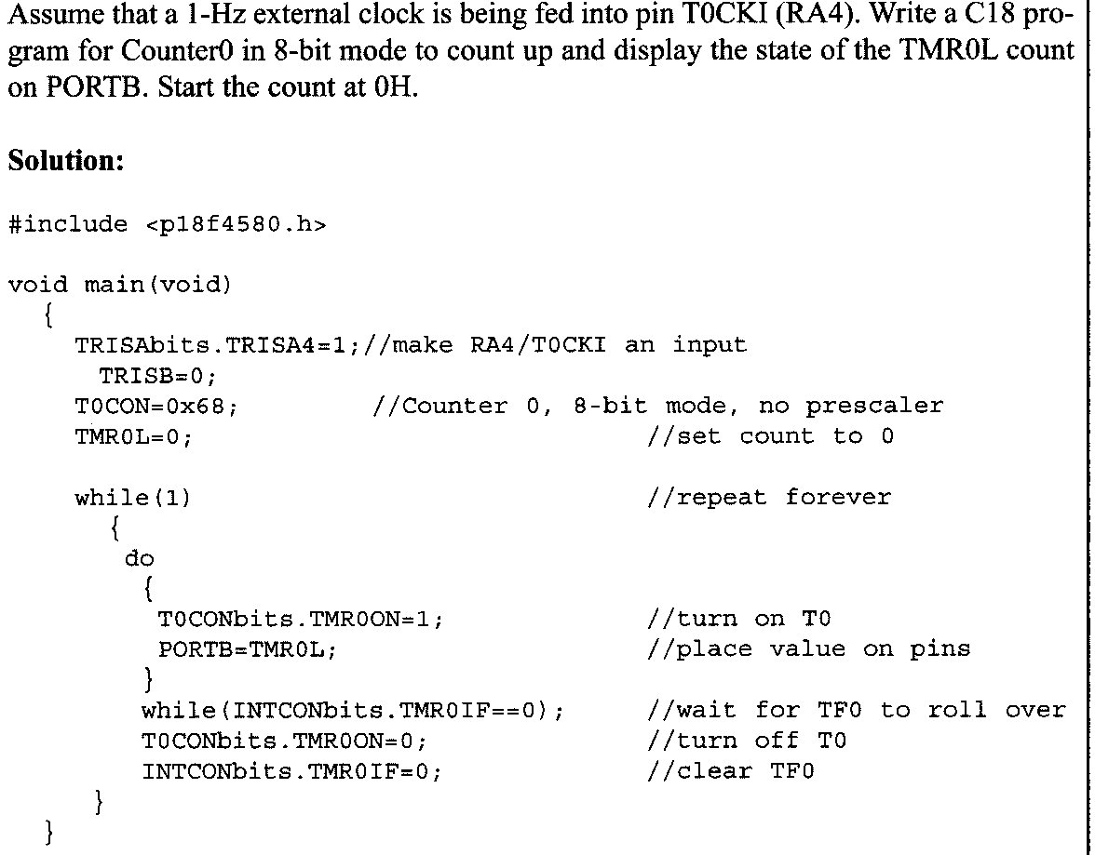
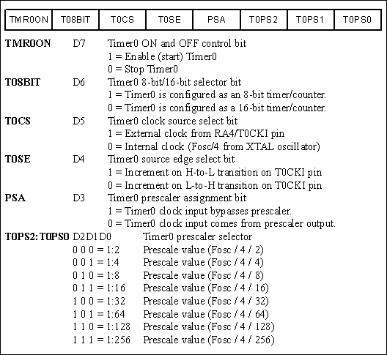

Slide 68
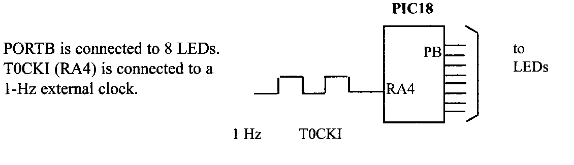

Slide 69
Programming Timers 2 & Timers3
Timer2 Programming
Timer2 is an 8-bit Timer.
8-bit register of Timer2 is called TMR2.
Timer2 also has an 8-bit register called the Period Register(PR2).
We can set the PR2 register to a fixed value & Timer2 will increment from 00 until it matches the value in PR2.
At that point, the equal signal will raise the TMR2IF flag & reset TMR2 to 00.

Slide 70
Clock source for Timer2 is Fosc/4 with the options of both prescaler & postscaler, as shown in fig 9-12.
Notice from fig that there is no external clock source for Timer2. Hence it cannot be used as a Counter.
Examine the next few examples to learn the programming syntax for Timer2. see Figure 9-12 & 9-13

Slide 71
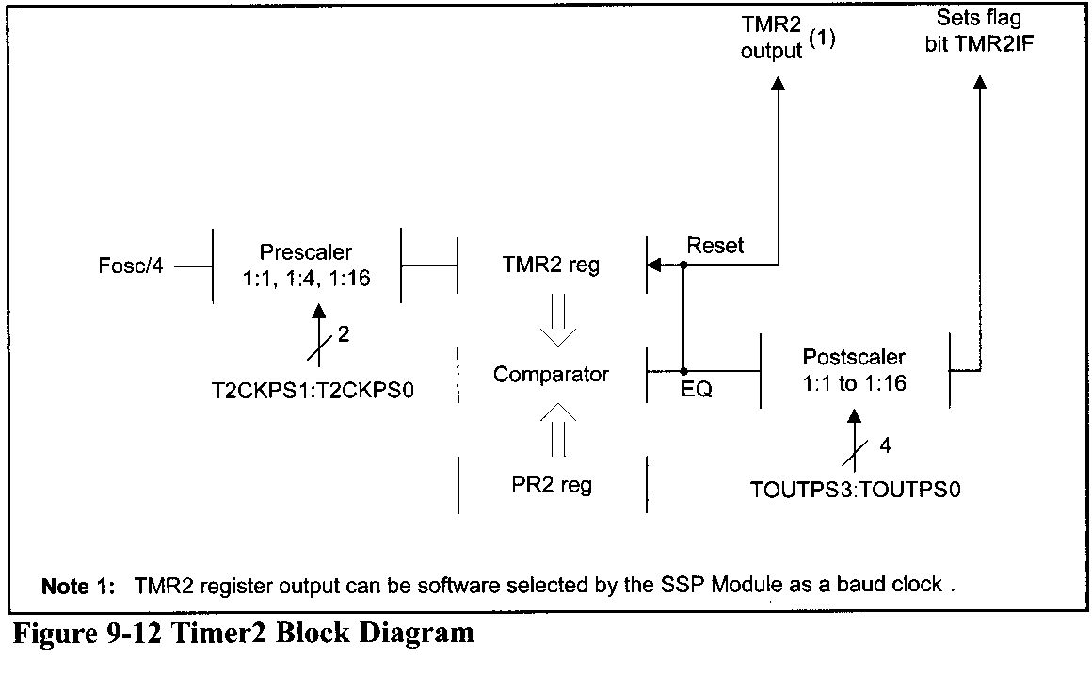

Slide 72
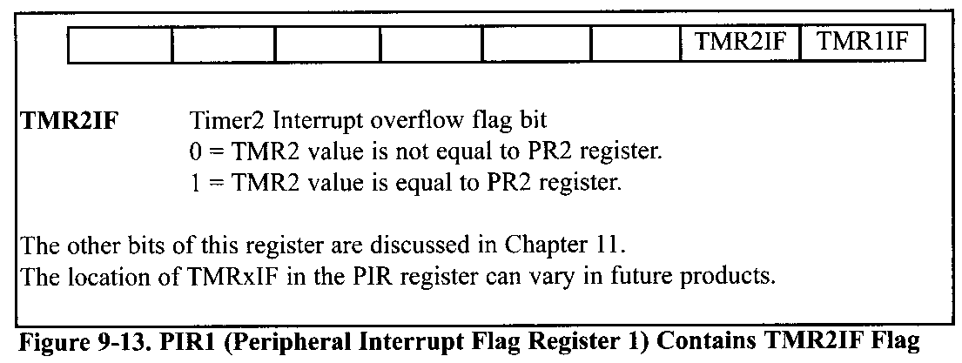

Slide 73
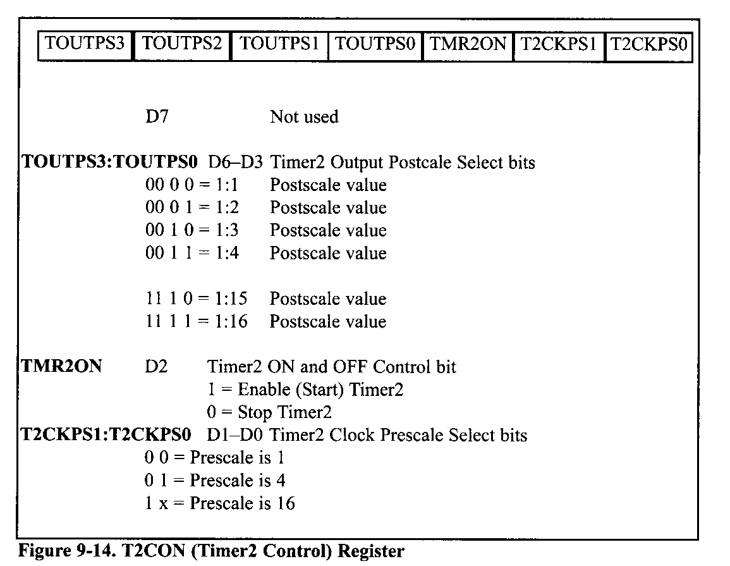

Slide 74
Timer3 Programming
Timer3 is a 16-bit timer that can be used as a Timer or Counter.
Its 16-bit register is split into 2 bytes referred to as TMR3L & TMR3H (see figure 9-17).
Timer3 can be programmed in 16-bit mode only & does not support 8-bit mode.
We select various options of Timer3 using the T3CON(Timer3 Control) register, as shown in figure 9-15.
Timer3 has the prescaler options of 1:1,1:2,1:4 & 1:8, as shown in figure 9-15.
Fig 9-15 also shows the bits related to the CCP(Compare/Capture pulse-width-modulation) feature of the PIC18.

Slide 75
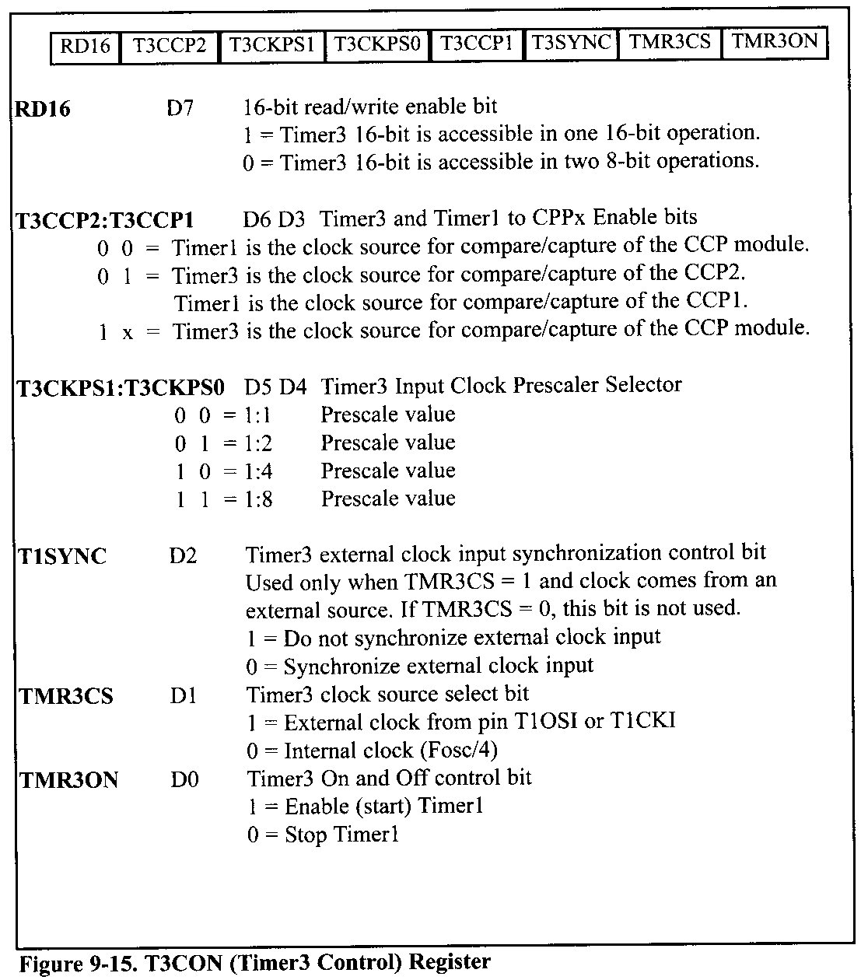

Slide 76
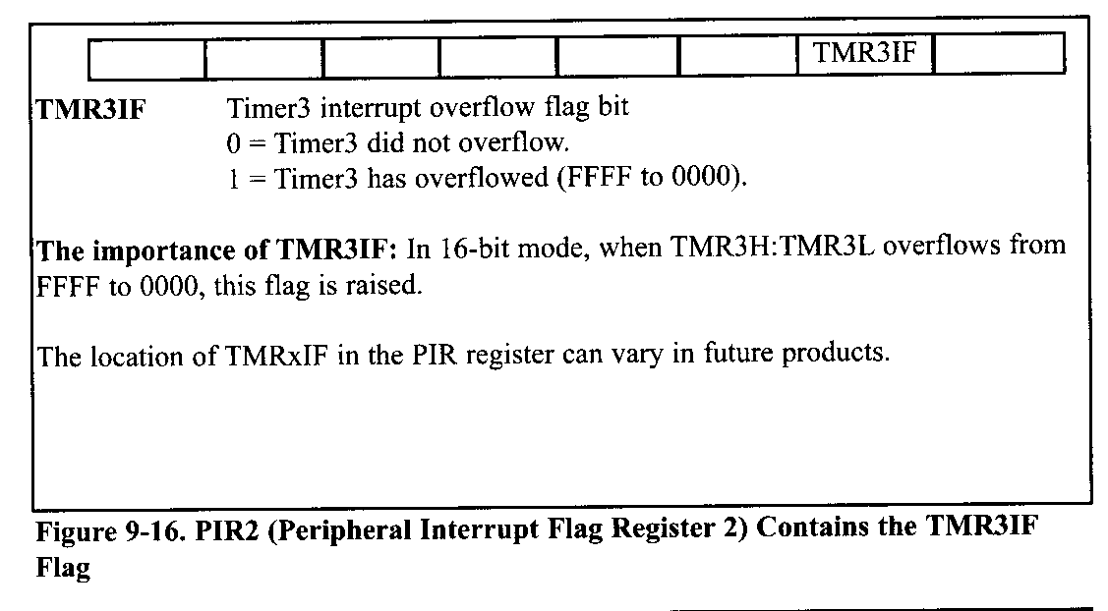

Slide 77
